Slide 1

Salary Analysis
SUBTITLE GOES HERE

Slide 2

YES YOU CAN
Salary and life
The following presentation was made with the purpose of showing techniques… database and history was invented so you can see that creativity has no boundaries.

Slide 3
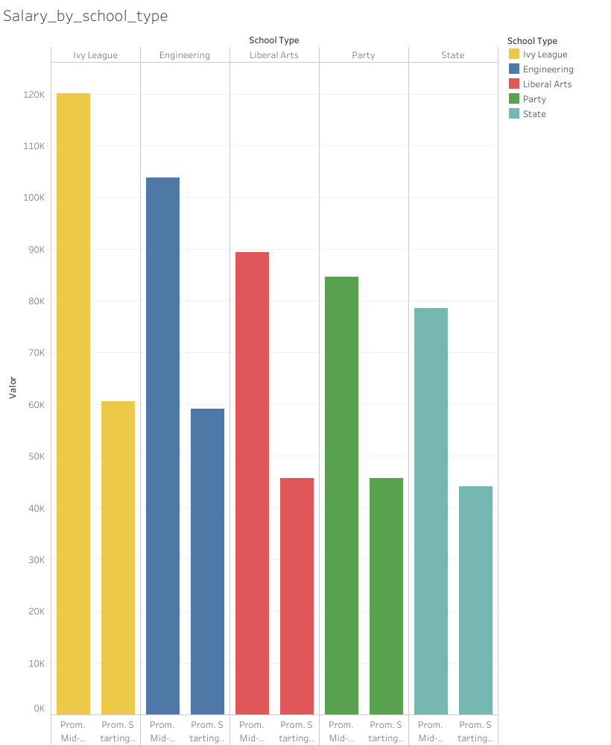
School Type
salary
School type determines in general the starting and mid level salary that you’ll have, being Ivy League the ones with more advantages..
But don’t get sad!
You can always change the numbers

Slide 4

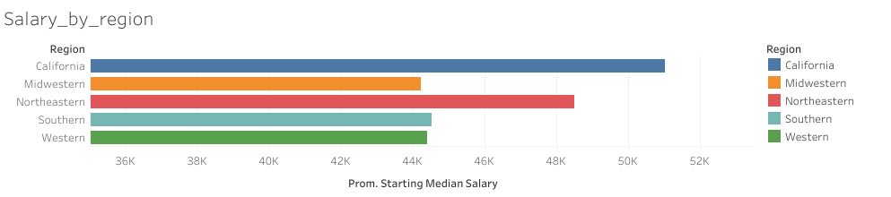
Let’s go to California!
California takes the advantage in paying more at a starting career level between different US regions…

Slide 5
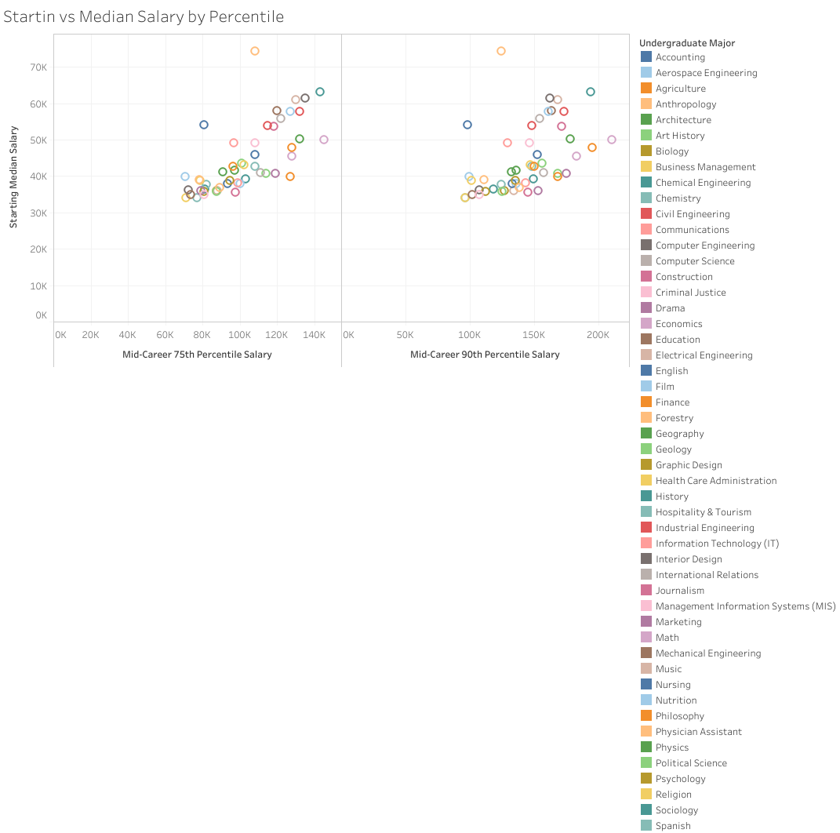
Salary by Major
SUBTITLE GOES HERE

Slide 6

BE THE change! THIS PRESENTATION JUST SHOWS SOME TECHNIQUES BETWEEN TABLEAU AND POWER POINT. GET OUT THERE AND BE THE DIFFERENCE!

Slide 7



THANK YOU
WWW.CYNTHIAHUALLANCA.GITHUB.IO/CH
Cynthia Huallanca
+1 (305) 804-5510
anaysisbych@gmail.com

